Slide 1



Latest Research Project
Jeongbin Park, M.Sc.^{1,2}
¹Department of Molecular Medicine and Biopharmaceutical Sciences Graduate School of Convergence Science and Technology, Seoul National University
²Portrai, Inc.
Notes:
Hello, everyone. My name is Jeongbin Park. Thank you for allowing me to have this opportunity.

Slide 2
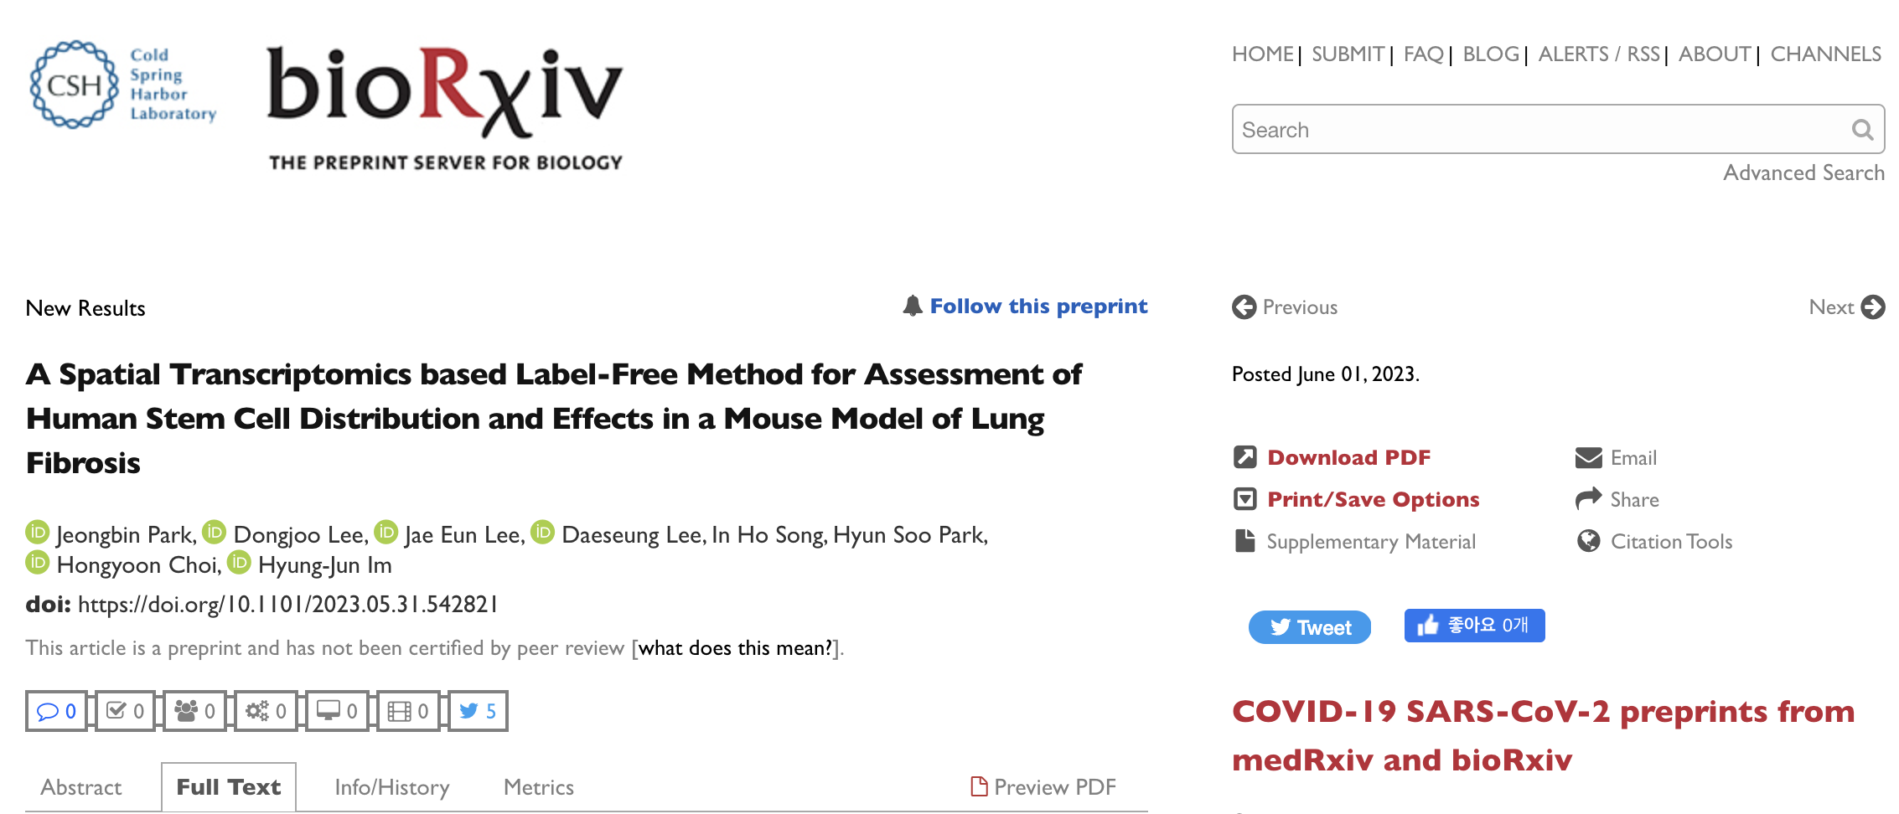
ST-based Label-Free Assessment Method for Cell Therapy
❗️ Front Matter
Notes:
Today, I’d like to introduce my latest research project named A Spatial Transcriptomics based Label-Free Method for Assessment of Human Stem Cell Distribution and Effects in a Mouse Model of Lung Fibrosis.

Slide 3
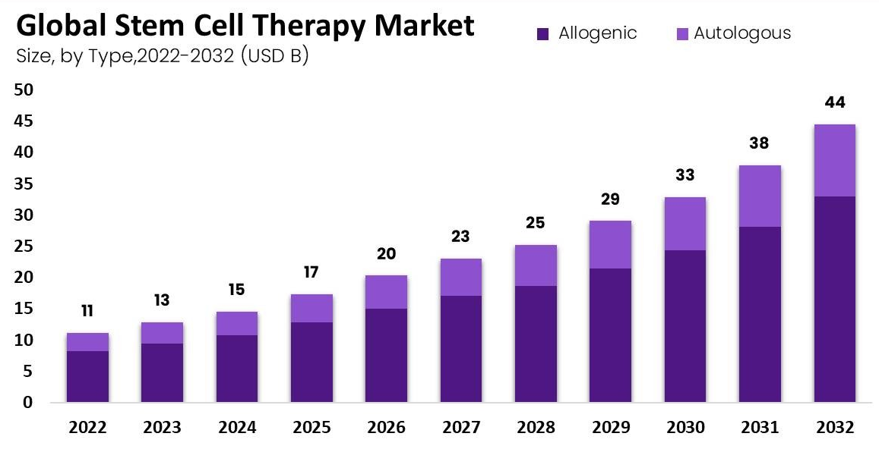
ST-based Label-Free Assessment Method for Cell Therapy
❗️ Background
Reference: Market News Live – Newsletter (LinkedIn)
Notes:
Cell therapy is the introduction of external therapeutic cells into patients, including CAR-T, CAR-NK, stem cells, and microbiome agents. As you all know, the therapy is getting popular and getting diverse.

Slide 4
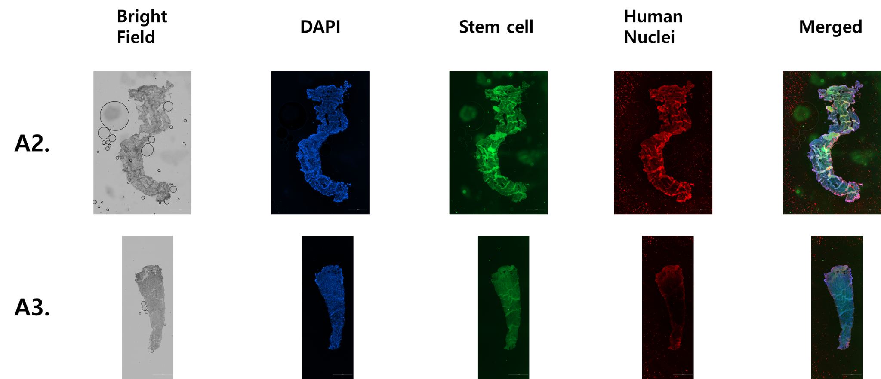
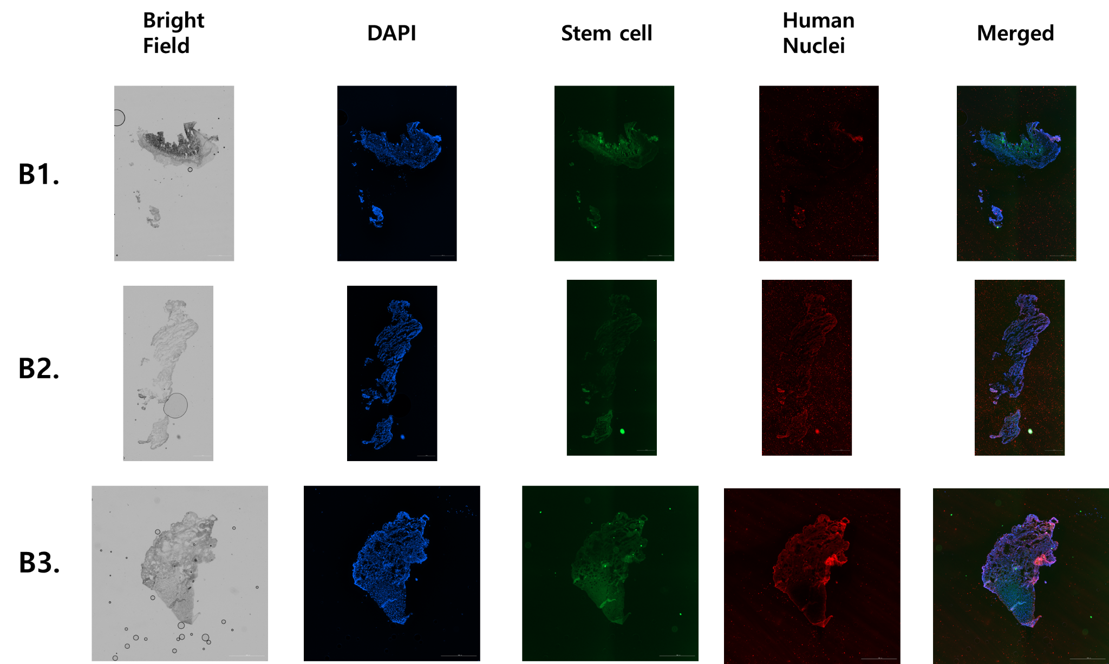
ST-based Label-Free Assessment Method for Cell Therapy
❗️ Background
My data
Notes:
However, I’ve experienced the difficulty of the microscopic assessment of the cell therapy including distribution and mechanism of action. For example, the images are fluorescence images acquired from bones and cartilages. Even if the stem cells are not injected in the samples, there are seemingly existent stem cells due to the autofluorescence.

Slide 5
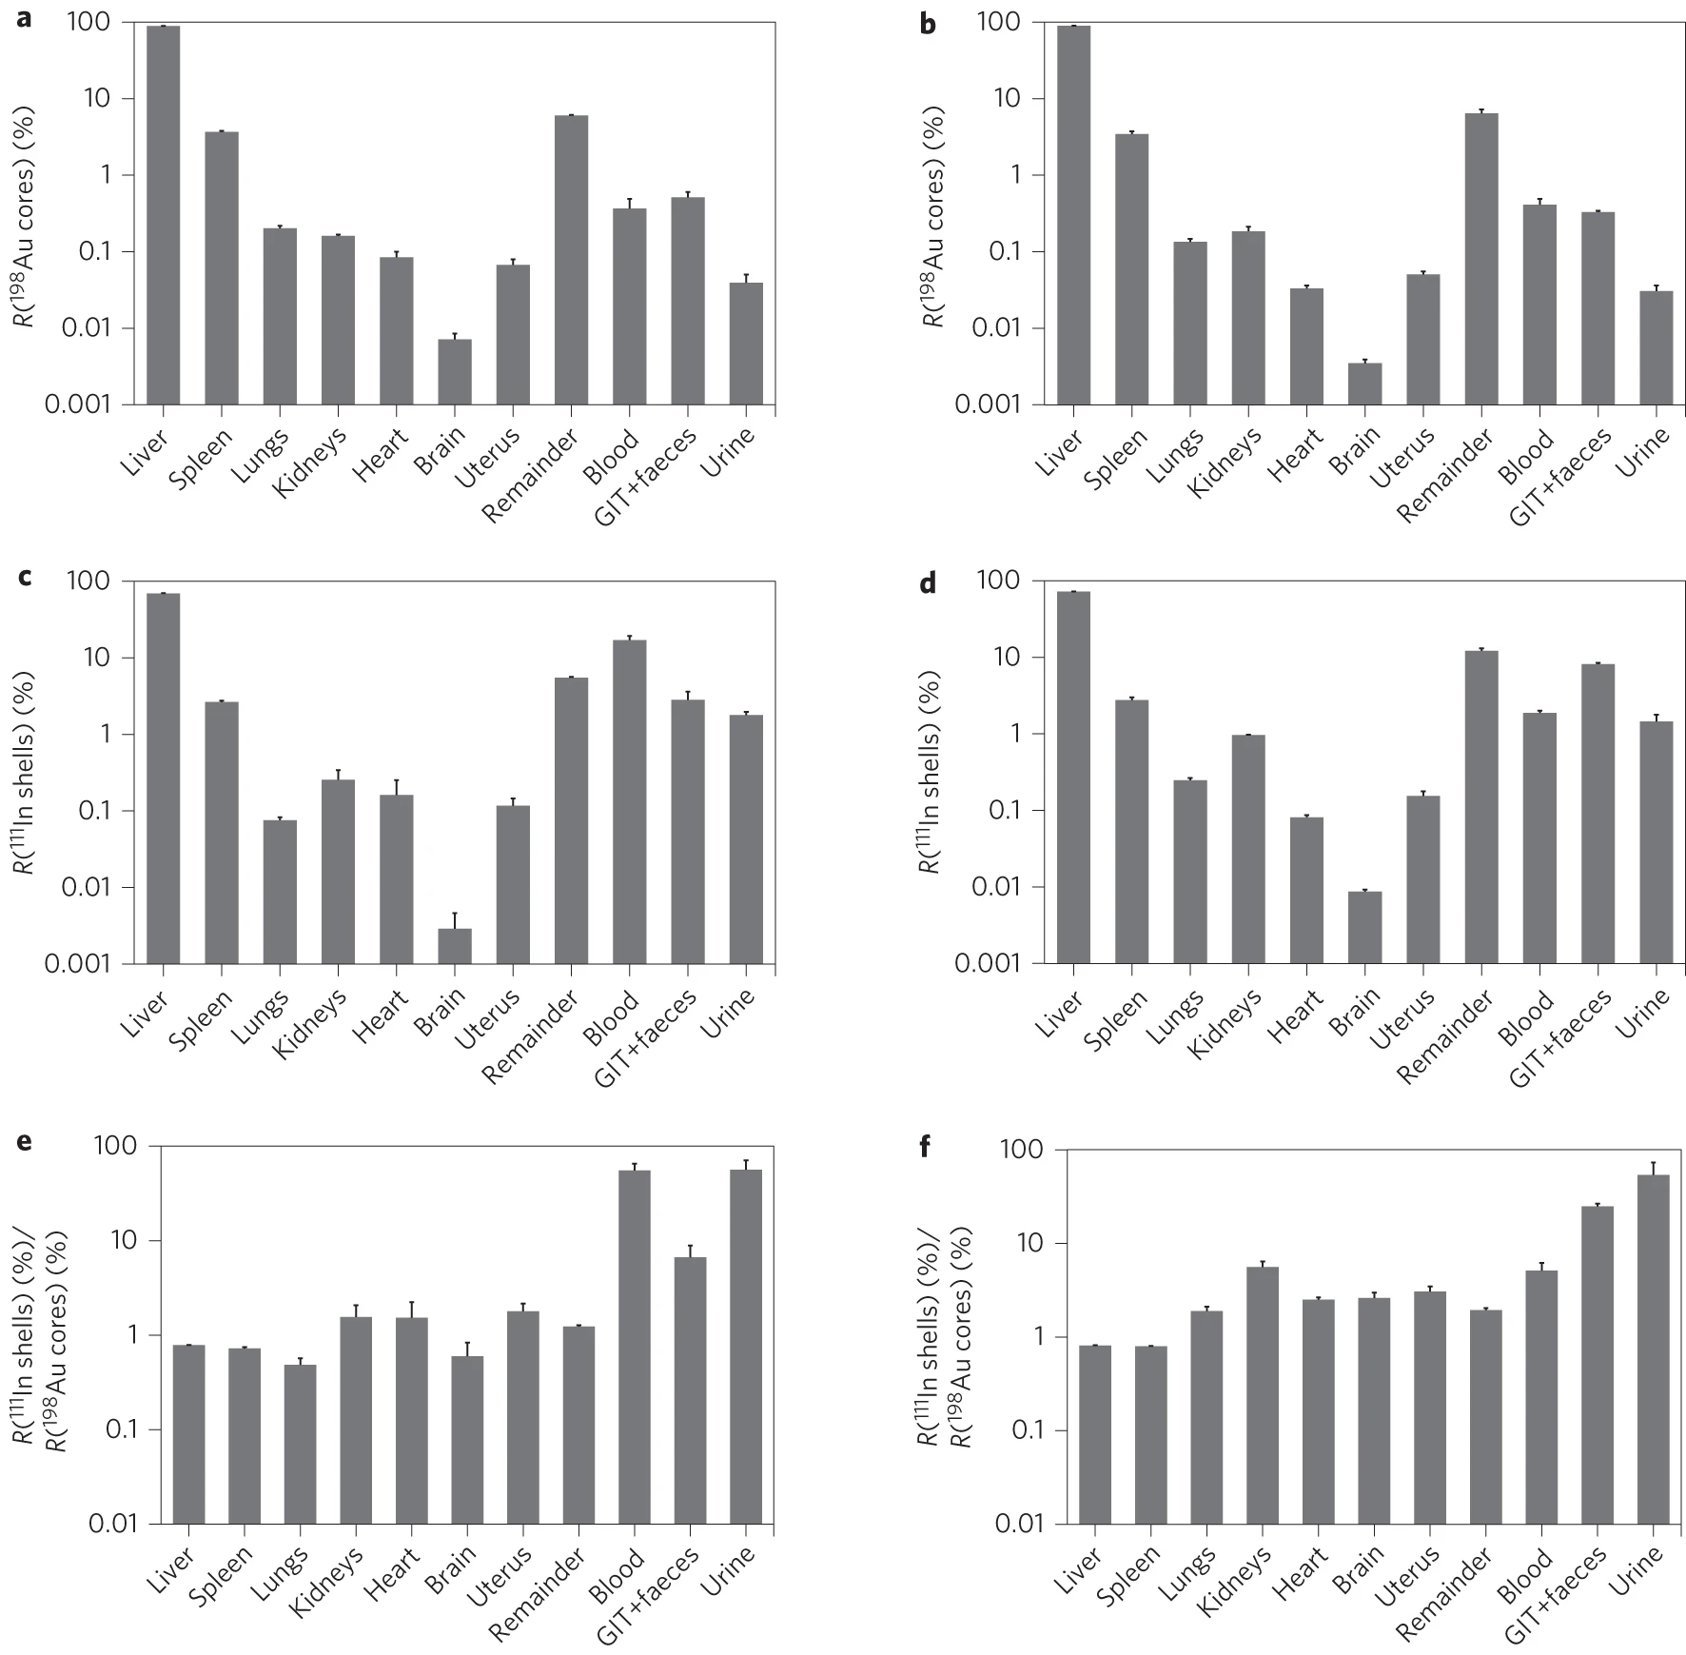
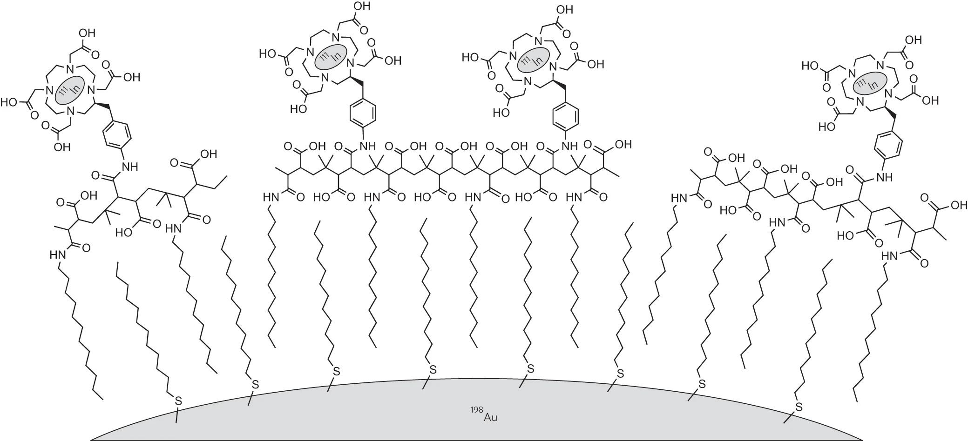
ST-based Label-Free Assessment Method for Cell Therapy
❗️ Background
Reference: PMID: 26076469; Nature Nanotechnology
Notes:
There is another problem related to the detachment of disintegration of the labeling materials. This figure shows dual labeling for shell and core materials, resulting in different biodistributions for both after administration.

Slide 6
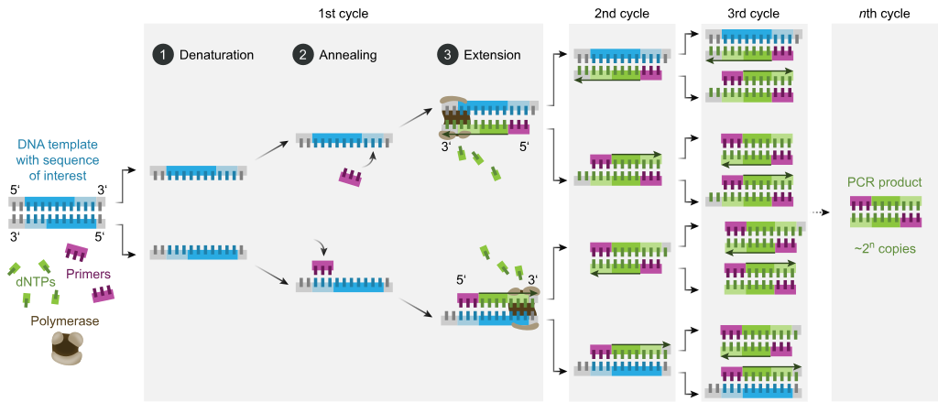
ST-based Label-Free Assessment Method for Cell Therapy
❗️ Background
Reference: Wiki
Notes:
PCR can be used to understand the distribution of cell therapeutic agents, but it cannot be done in organ resolution.

Slide 7
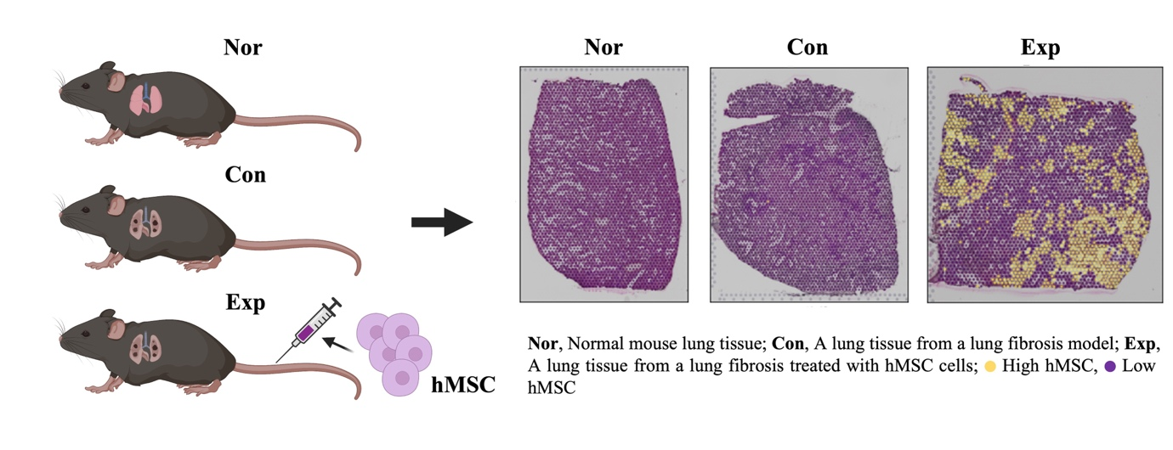
ST-based Label-Free Assessment Method for Cell Therapy
❗️ Results
First-authored; bioRxiv
Notes:
Thus, I developed label-free method that manipulates the interspecies transcripts difference when cell therapeutic agents are introduced. This can also be applied to exogenous nucleic acids. My colleague prepared three samples, named Nor, Con, and Exp. Exp sample is the only sample with human mesenchymal stem cell injection. As a result, I successfully differentiated the distribution of hMSC from host.

Slide 8
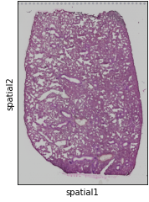
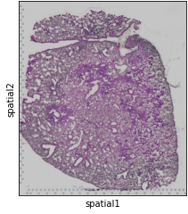
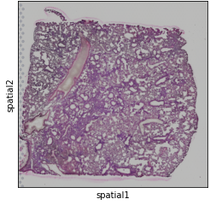
ST-based Label-Free Assessment Method for Cell Therapy
❗️ Results
First-authored; bioRxiv
Notes:
The fibrotic lung tissues in the Con sample and the Exp sample show observable fibrotic tissue sections, as expected.

Slide 9
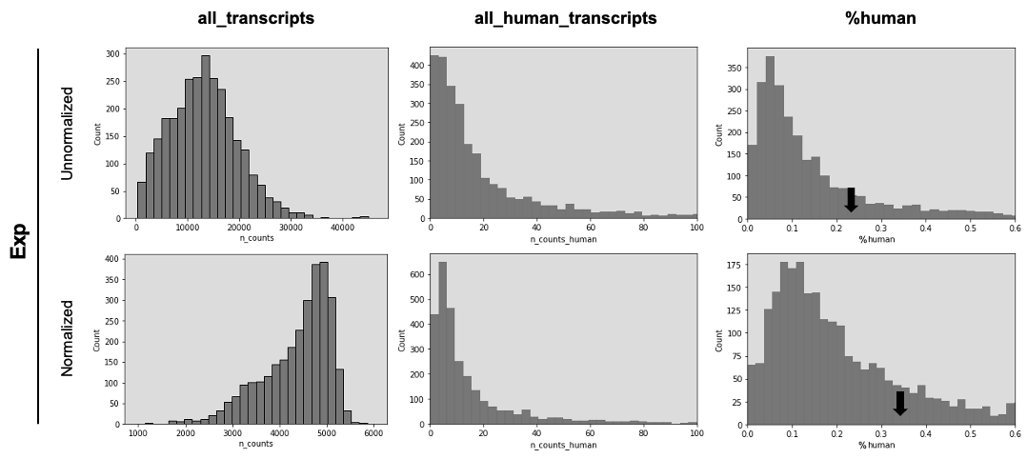
ST-based Label-Free Assessment Method for Cell Therapy
❗️ Results
First-authored; bioRxiv
Notes:
As the normalization can increase the statistical power to detect human transcripts percentage for a single spot or %human, I only considered normalized counts for subsequent analyses.

Slide 10
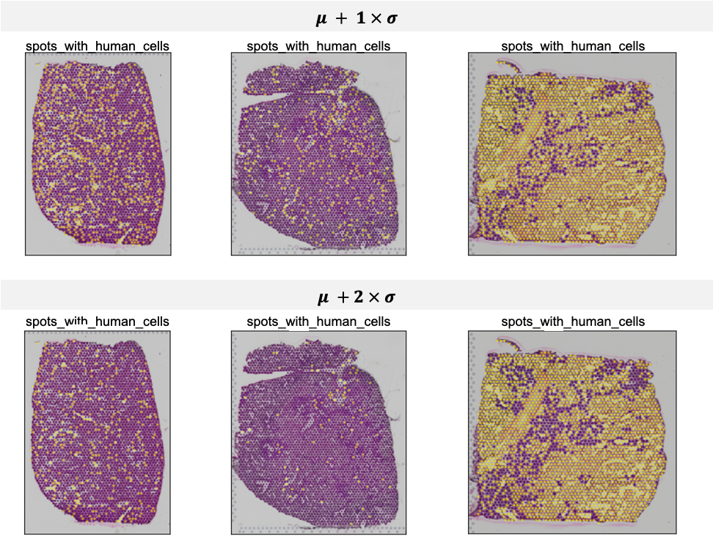
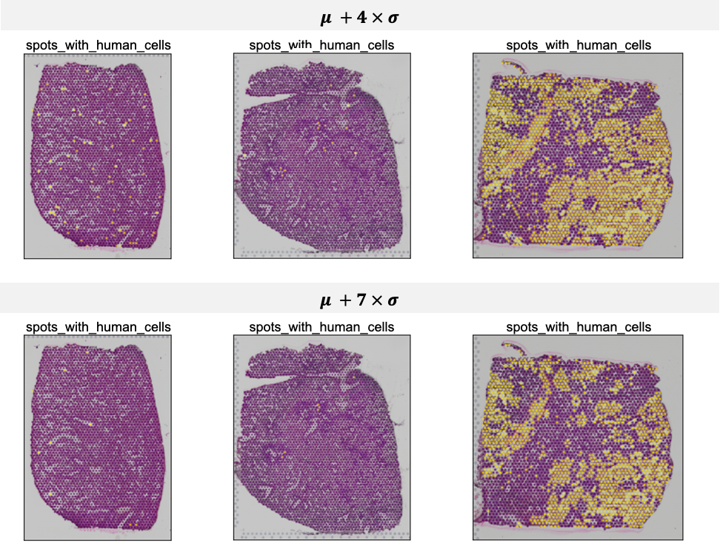
ST-based Label-Free Assessment Method for Cell Therapy
❗️ Results
First-authored; bioRxiv
Notes:
Various kinds of thresholds were attempted to indicate the distribution of human cells by dichotomy. The thresholds were based on the control sample.

Slide 11
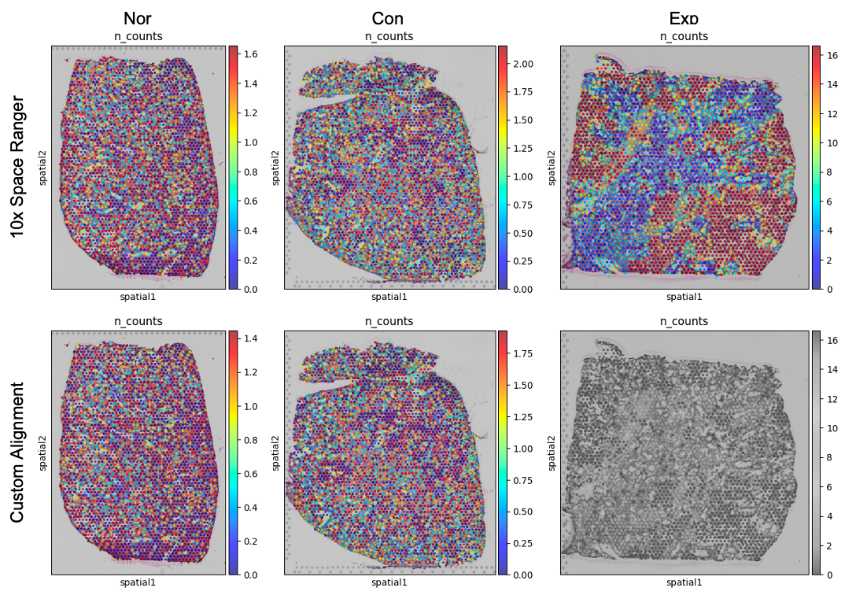
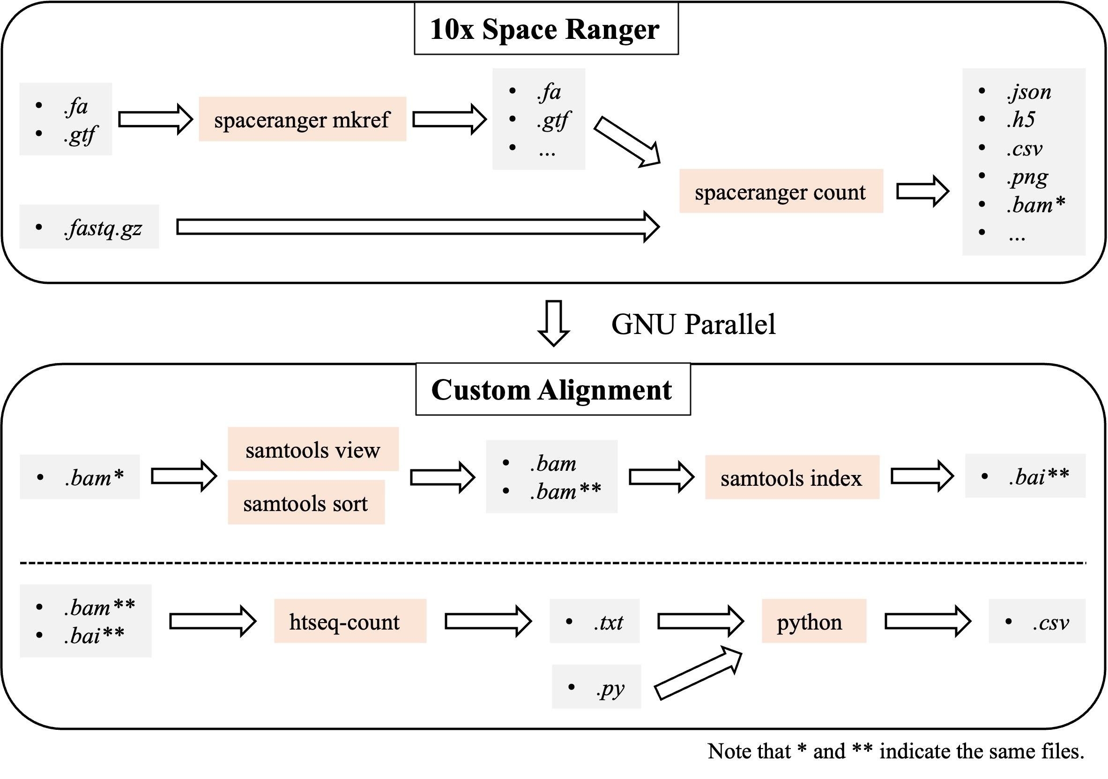
ST-based Label-Free Assessment Method for Cell Therapy
❗️ Results
Normalized human transcripts
Will be updated
First-authored; bioRxiv
Notes:
There are two pipelines to differentiate the human and mouse transcripts. The first one is 10x Space Ranger. And the other one is custom alignment I developed recently. As a result, both pipelines show similar results, implying the robustness of human transcripts detection regardless the alignment method chosen. Still, Space Ranger seems to be a little better as can be seen in a slightly higher human transcripts in the Exp sample.

Slide 12
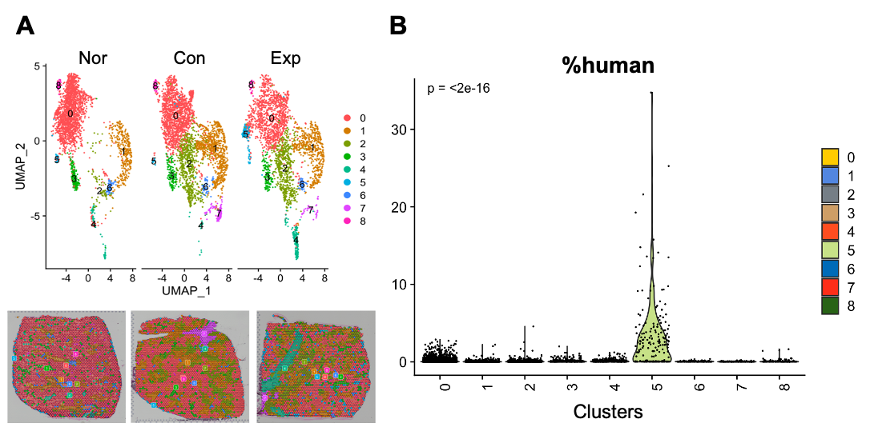
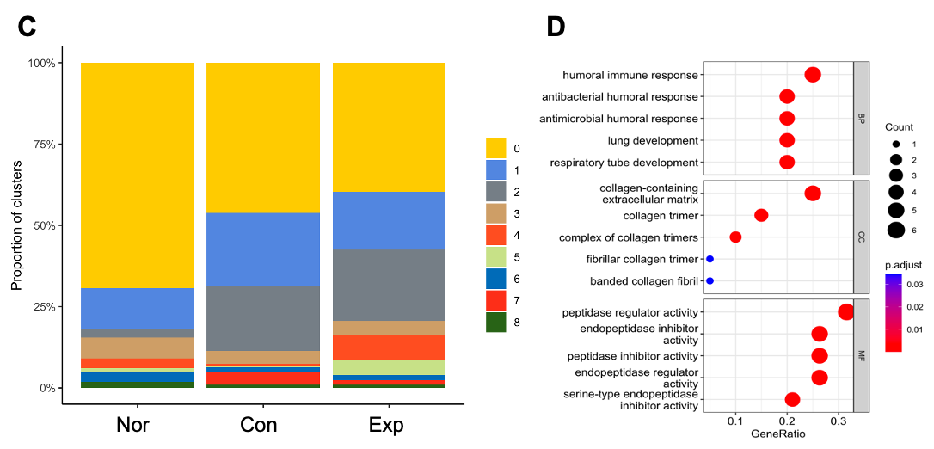
ST-based Label-Free Assessment Method for Cell Therapy
❗️ Results
✔️ Top 20 SEGs: immune response, collagen-containing extracellular matrix (ECM), and peptidase activity
✔️ SEGs are thought to be HMSC-driven activity.
First-authored; bioRxiv

Slide 13
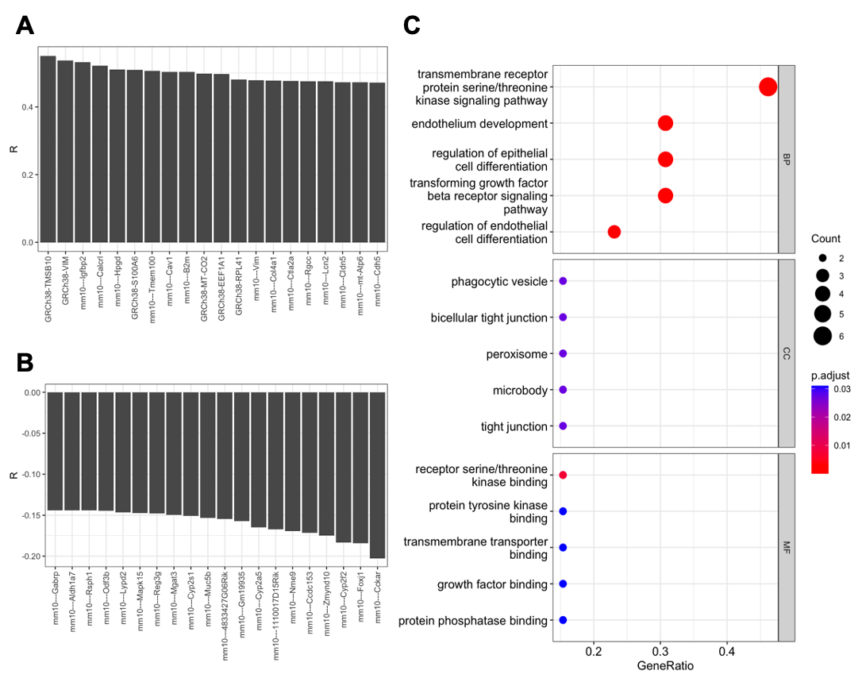
ST-based Label-Free Assessment Method for Cell Therapy
❗️ Results
✔️ (+) cor with %human: 6 human, 14 mouse
✔️ SEGs ∩ SAGs = Lcn2, Col4a1
Co-first-authored; submitted

Slide 14
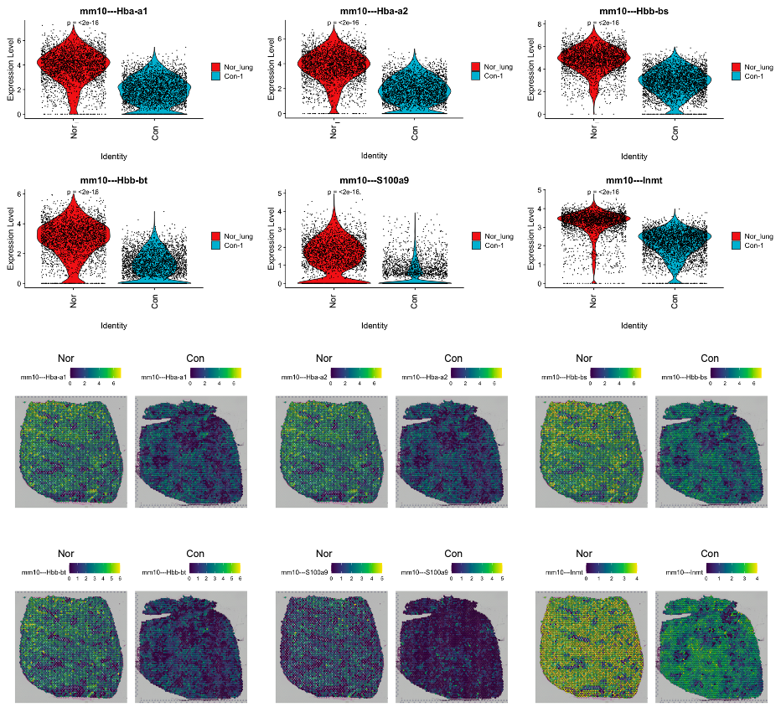
ST-based Label-Free Assessment Method for Cell Therapy
❗️ Results
✔️ Nor > Con: Hba-a1, Hba-a2, Hbb-bs, Hbb-bt
Co-first-authored; submitted

Slide 15
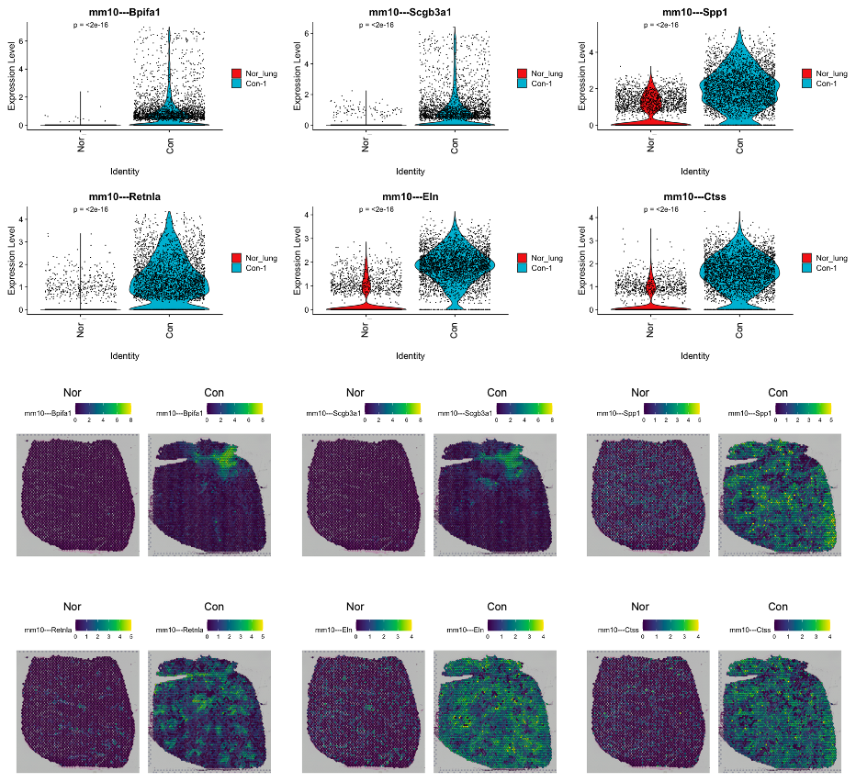
ST-based Label-Free Assessment Method for Cell Therapy
❗️ Results
✔️ Nor < Con: Bpifa2
Co-first-authored; submitted

Slide 16
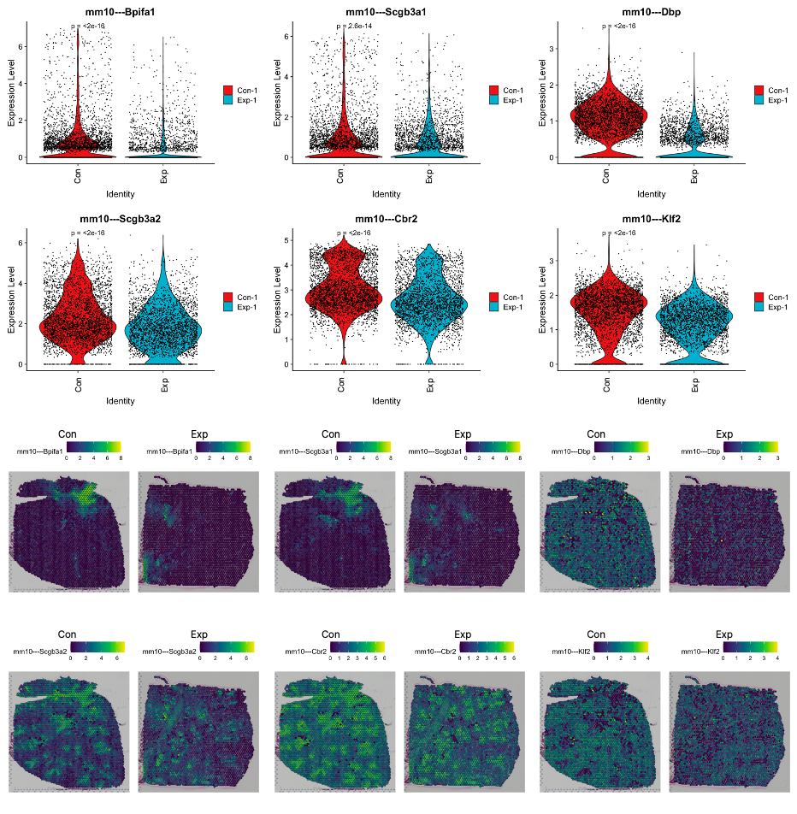
ST-based Label-Free Assessment Method for Cell Therapy
❗️ Results
✔️ Con > Exp: Bpifa2
Co-first-authored; submitted

Slide 17
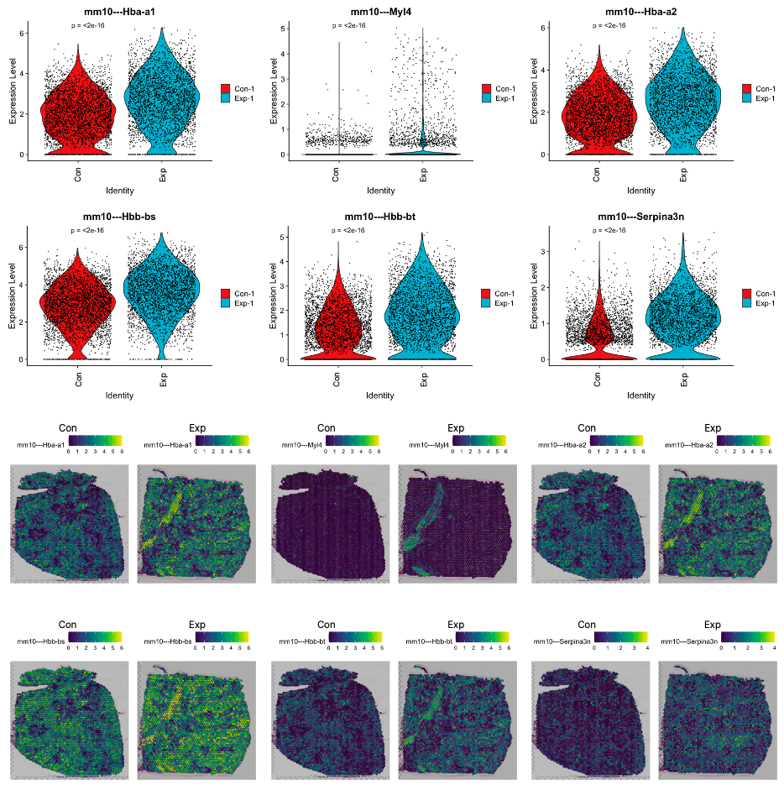
ST-based Label-Free Assessment Method for Cell Therapy
❗️ Results
✔️ Con < Exp: Hba-a1, Hba-a2, Hbb-bs, Hbb-bt
Co-first-authored; submitted

Slide 18
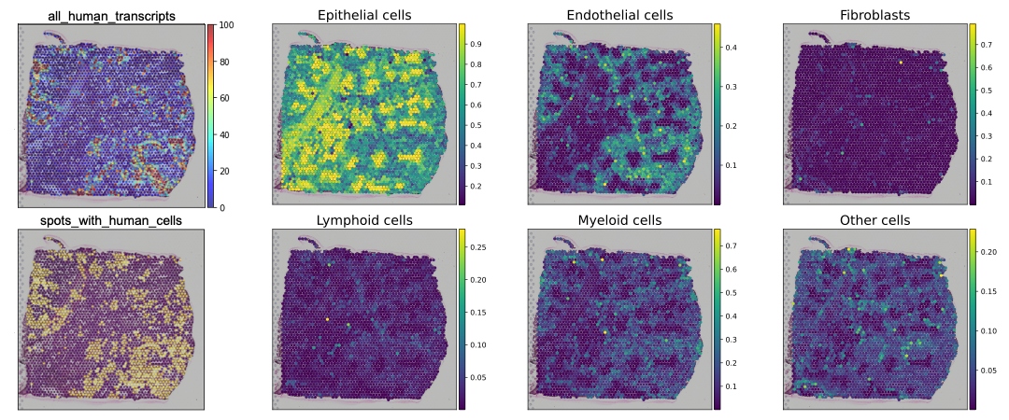
ST-based Label-Free Assessment Method for Cell Therapy
❗️ Results
Co-first-authored; submitted

Slide 19
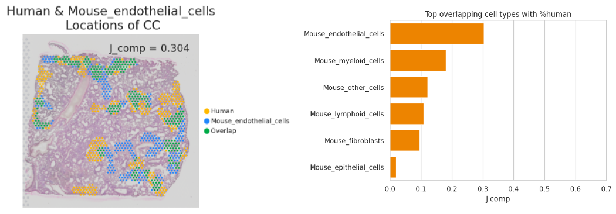
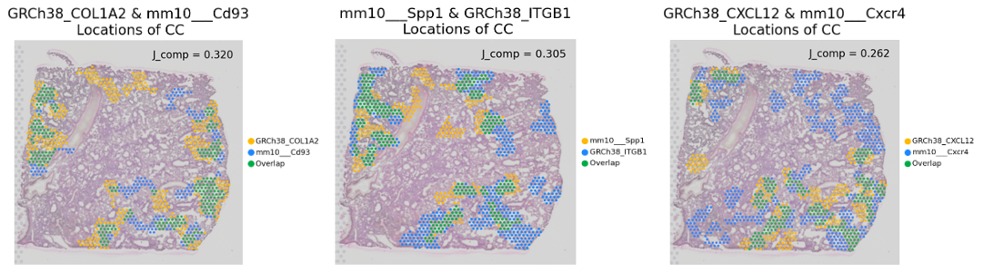
ST-based Label-Free Assessment Method for Cell Therapy
❗️ Results
Co-first-authored; submitted

Slide 20
ST-based Label-Free Assessment Method for Cell Therapy
❗️ Results
❗️ Mouse vs Human endothelial spots
✔️ Apoe, Col1a1, and Hnrnpab are up-regulated in mouse endothelial spots.
✔️ mt-Co2, Lcn2, Gm42418, Chil1, Scd1, mt-Nd1, and mt-Nd2, along with 43 human genes are up-regulated in
human endothelial spots.
❗️ Lcn2
✔️ SEGs ∩ SAGs ∩ Genes enriched in human endothelial spots = Lcn2
✔️ Lcn2 is a marker gene for luminal epithelial cells in the mammary gland and goblet cells in the trachea.
✔️ Lcn2 expression may be triggered by hMSCs (∵ SEGs) and endothelial cells (∵ human-mouse interaction).
Co-first-authored; submitted

Slide 21
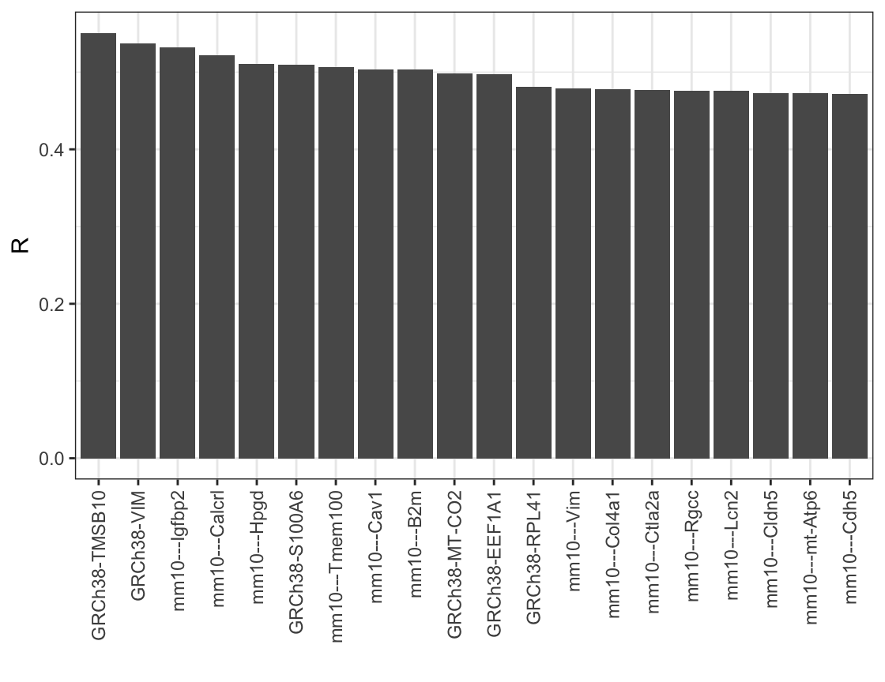
ST-based Label-Free Assessment Method for Cell Therapy
❗️ Conclusion
❗️ Key findings
✔️ RNA transcripts originating from different genomes can be discriminated.
✔️ Significantly associated genes with the hMSCs can be obtained by SEGs, DEGs, and SAGs.
✔️ Stem cells displayed a strong association with endothelial cells.
❗️ Discussion
✔️ Replicate samples and multiple time points are required.
✔️ False positive human transcripts detection problem.
✔️ False negative human transcripts detection problem. (▶)
Co-first-authored; submitted

Slide 22
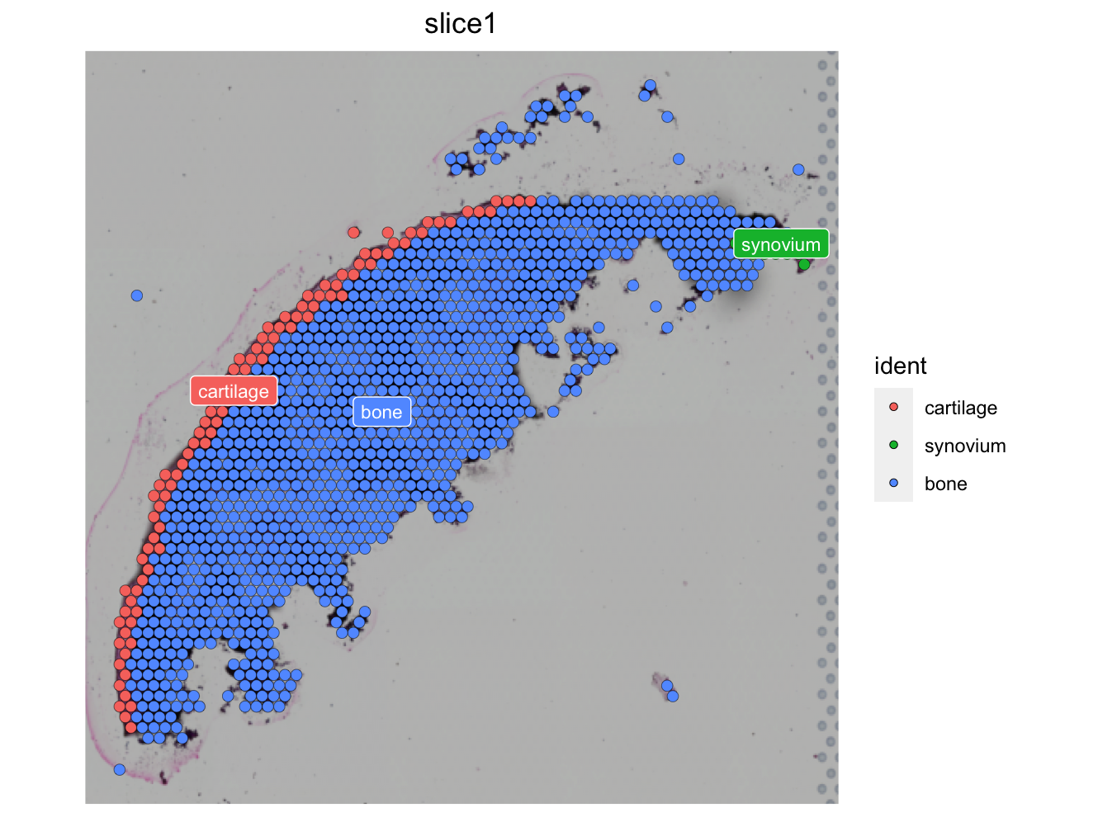
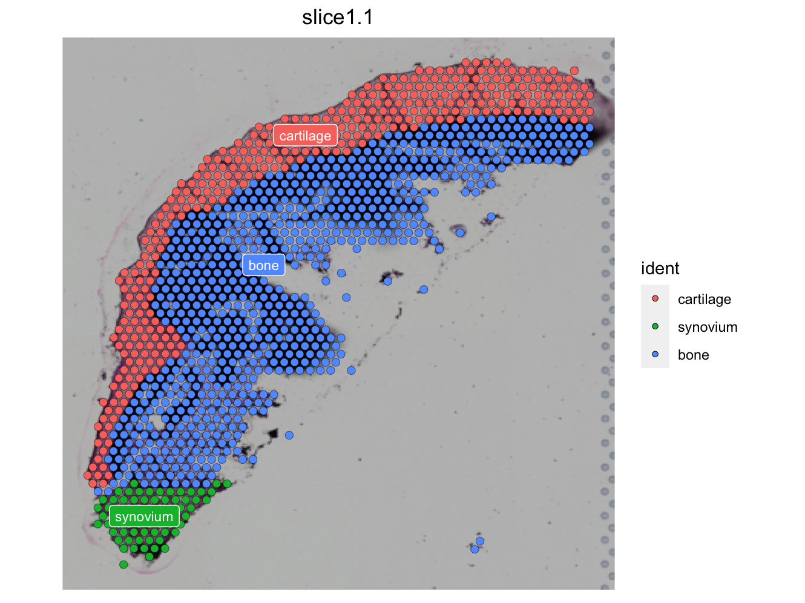
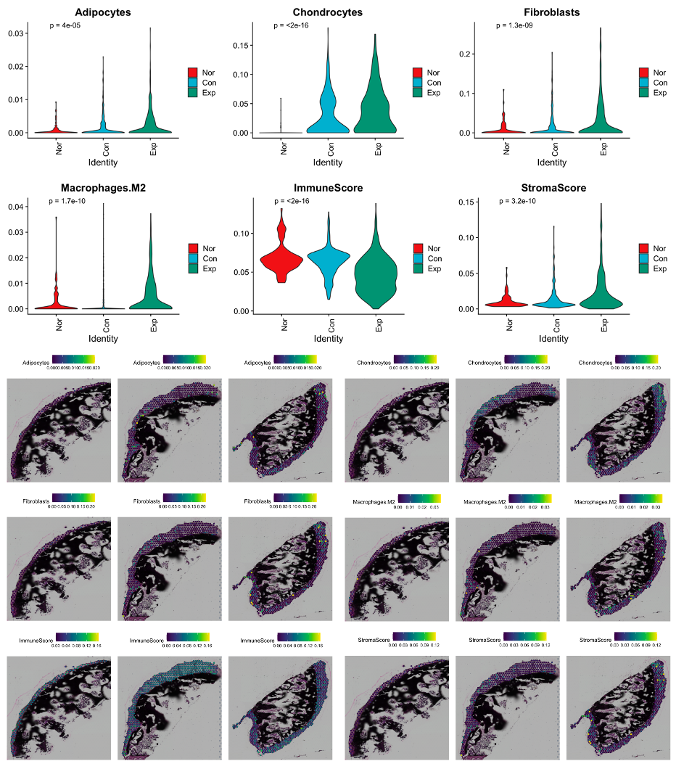
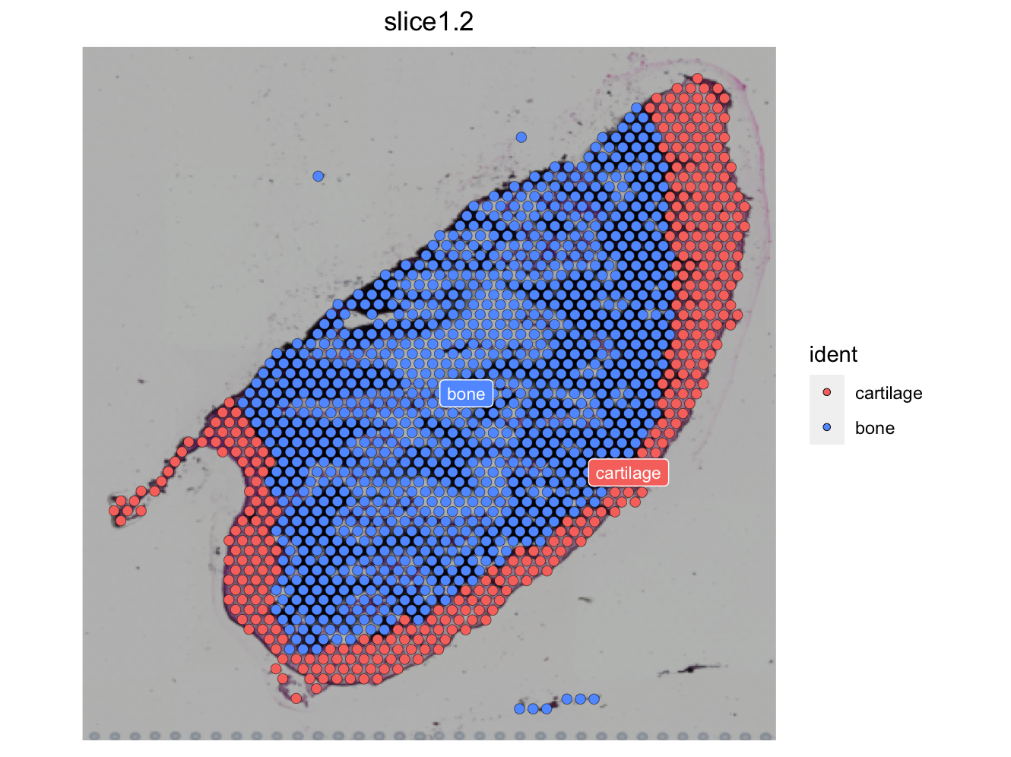
ST-based Label-Free Assessment Method for Cell Therapy
❗️ In Progress
My data
Notes:
I believe spatial clustering should aim to be structurally meaningful.

Slide 23
ST-based Label-Free Assessment Method for Cell Therapy
❗️ In Progress
My data
Notes:
Spatial Feature Plot and Violin Plot

Slide 24
ST-based Label-Free Assessment Method for Cell Therapy
❗️ In Progress
My data
Notes:
IAMSAM app

Slide 25
Thank You
Notes:
Thank you.

